Slide 1
RISC-V Instruction Formats I
Slides: PDF
(example typos fixed post-lecture)

Slide 2

Apple Career Talk
New Silicon Initiative: Women in
Hardware Technologies Speaker Series
Apple
Wednesday, February 26, 2025
1:00 p.m. PT, via WebEx
Registration: (flyer, Ed thread)

Slide 3
Machine Language

Slide 4
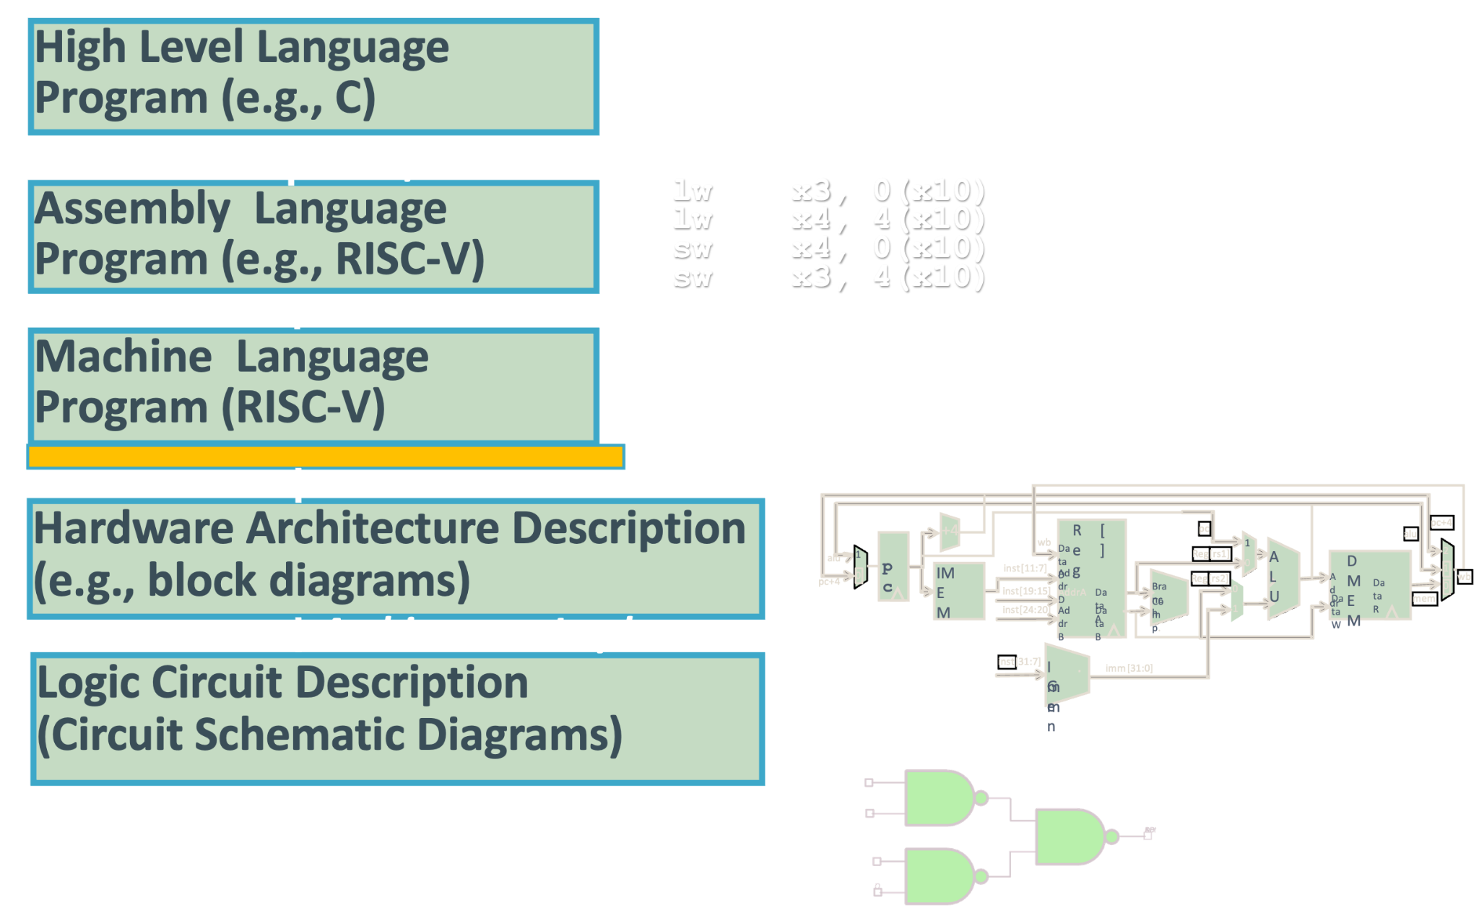
Great Idea #1: Abstraction (Levels of Representation/Interpretation)
Notes:
TODO: adjust to shapes

Slide 5
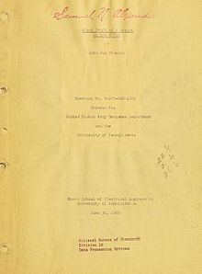
History’s Big Idea: Stored Program Computer
Stored-Program Computer AKA the “von Neumann” computer is named after the widely distributed tech report.
Based on discussions of EDVAC (1944-): Eckert, Mauchly; anticipated earlier by Turing and Zuse
Instructions are represented as bit patterns (i.e., numbers).
Therefore, entire programs can be stored to memory to be read or written, just like data.
This means reprogramming can happen quickly (seconds); don’t have to rewire computer (days).
First Draft of a Report on the EDVAC
By John von Neumann
Contract No. W–670–ORD–4926
Between the United States Army Ordnance Department and the University of Pennsylvania Moore School of Electrical Engineering, University of Pennsylvania
June 30, 1945
CS61C core concepts reinforce the stored-program computer model!
Notes:
Herman Goldstine
Alan Turing, Konrad Zuse

Slide 6
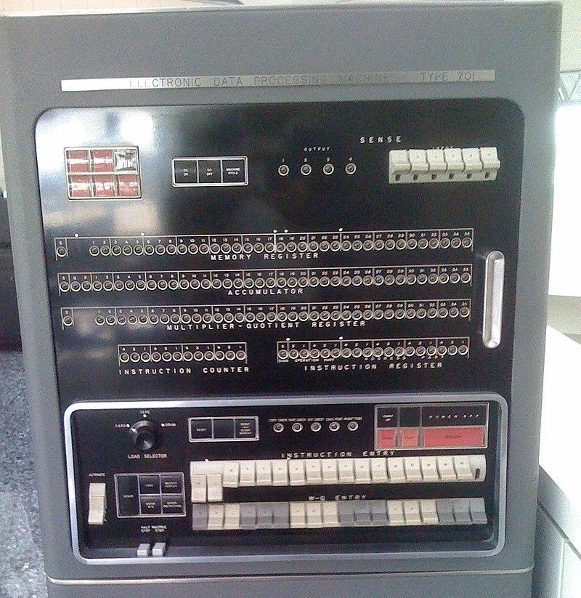
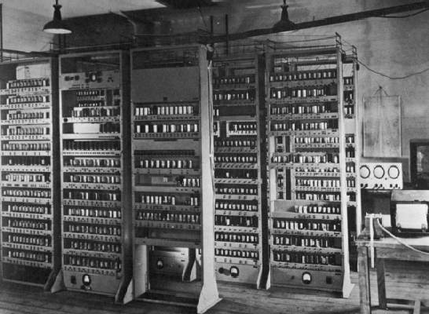
Quick CS History
EDSAC: Cambridge, 1949: First General Stored-Program Electronic Computer
17-bit words (35-bit double word), binary 2’s complement
Memory: 512 words
Multiplication: 6ms
Subroutines
IBM 701 (1952): IBM’s first commercial scientific computer
36-bit sign-magnitude words
Memory: 2048 words with vacuum tubes
Multiplication: <0.5 ms
Two programmer-accessible registers: Accumulator, Multiplier/Quotient
Image source
At some point,
Notes:
EDVAC: Electronic Discrete Variable Automatic Computer
EDSAC: Electronic Delay Storage Automatic Calculator

Slide 7
Core Concepts Reinforce Stored Program Computer
Everything (instructions, data words) has a memory address.
Both branches and jumps use instruction memory addresses.
The Program Counter (PC) register keeps address of instruction being executed.
PC is effectively a pointer to memory
Intel calls it Instruction Pointer (PC).
Programs are distributed in binary form, i.e., as assembled machine code.
Programs are each bound to a specific instruction set.
Different instruction sets, e.g., for phone vs. PCs.
Many instruction sets are backwards-compatible and evolve over time, e.g., latest PCs with x86 ISA today can still run programs from Intel 8088 (1981)!

Slide 8
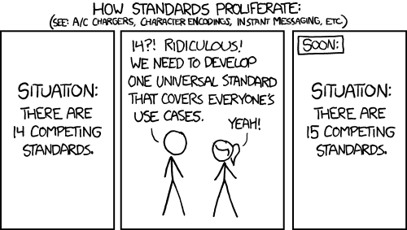
Today: Understand the why behind RISC-V ISA
Just one standard in this class:
RV32I ISA (RISC-V 32-bit Integer Instructions)
It’s beautifully designed!
xkcd, explainxkcd

Slide 9
RISC-V ISA
[review]
An Instruction Set Architecture (ISA) defines what operations a particular CPU supports, and how it implements them.
Assembly language: the low-level CPU instructions
Machine language: how the instructions are represented, in bits
Fundamental architectural features and design
RISC-V ISA defines instructions for CPU down to the bit level:
Remember: Computer only understands 1s and 0s. Text like “add x18,x19,x10” is meaningless to hardware.
add x18, x19, x10
00000000101010011000100100110011
assembly code
machine code
Let’s learn instruction formats. Most of this lecture is on the CS61C reference card. No need to memorize exact machine code/bits!

Slide 10
RV32I Instructions: 32 bits wide, 6 Formats
RISC-V simplicity: Split everything into words (32-bit chunks).
Recall 32b registers; lw, sw access memory one word at a time.
Similarly, RISC-V instructions are also 32-bit words, fixed size
We cover RV32I (32-bit integer instructions).
Same 32-bit instructions used for RV32, RV64, RV128
RISC-V simplicity: The ISA defines six basic instruction formats.
32b instruction word divided into fields. Each field tells processor something about the instruction.
For similar instructions, use same format, same field definitions.
Today; R-, I-, S-Type Instruction Formats
Next time: B-, U-, J-Type Instruction Formats

Slide 11
R-Type Instructions

Slide 12
R-Type Instruction Format (1/3)
opname rd rs1 rs2
field’s bit positions
31 | 25 | 24 | 20 | 19 | 15 | 14 | 12 | 11 | 7 | 6 | 0
funct7 |  | rs2 |  | rs1 |  | funct3 |  | rd |  | opcode
7 |  | 5 |  | 5 |  | 3 |  | 5 |  | 7
name of field
#bits in field
Register-Register Arithmetic Instructions
All arithmetic functions that operate on registers (add, xor, sll, etc.) assume these bit fields.

Slide 13
R-Type Instruction Format (2/3)
opname rd rs1 rs2
31 | 25 | 24 | 20 | 19 | 15 | 14 | 12 | 11 | 7 | 6 | 0
funct7 |  | rs2 |  | rs1 |  | funct3 |  | rd |  | opcode
7 |  | 5 |  | 5 |  | 3 |  | 5 |  | 7
“Source” Register 2
second operand
“Source” Register 1
second operand
“Destination” Register
gets result of computation
Register fields: rs1, rs2, rd
A 5-bit unsigned integer [0-31] corresponds to a register number (x0-x31).
a0 → x10 → 0b01010

Slide 14
R-Type Instruction Format (3/3)
opname rd rs1 rs2
31 | 25 | 24 | 20 | 19 | 15 | 14 | 12 | 11 | 7 | 6 | 0
funct7 |  | rs2 |  | rs1 |  | funct3 |  | rd |  | opcode
7 |  | 5 |  | 5 |  | 3 |  | 5 |  | 7
All R-type instructions have the same 7-bit opcode.
R-Type: opcode 0110011.
Fields: funct7, funct3, opcode
What instruction format to use (opcode)
R-format: What operation to perform (funct3, funct7)
Why not just a 17-bit field for simplicity? (more later)

Slide 15
R-Type Example
add x18 x19 x10
31 | 25 | 24 | 20 | 19 | 15 | 14 | 12 | 11 | 7 | 6 | 0
funct7 |  | rs2 |  | rs1 |  | funct3 |  | rd |  | opcode
0000000 |  | 01010 |  | 10011 |  | 000 |  | 10010 |  | 0110011
7 |  | 5 |  | 5 |  | 3 |  | 5 |  | 7
x10
x19
x18
R-Type opcode
Determine opcode, funct3, funct7 from reference card
Translate registers, etc.
(optional) Convert to hex
“add”
🏡

Slide 16
Your Turn: Hex → Instruction
Translate these 32 bits into a RISC-V instruction:
0x01B3 42B3
1. Convert to binary → find opcode → find instruction format type
0b0000 0001 1011 0011 0100 0010 1011 0011
A. slt x5 x6 x27
B. slt x27 x5 x6
C. slt x5 x27 x6
D. xor s11 t0 t1
E. xor t0 t1 s11
F. xor t0 s11 t1
G. Something else

Slide 17
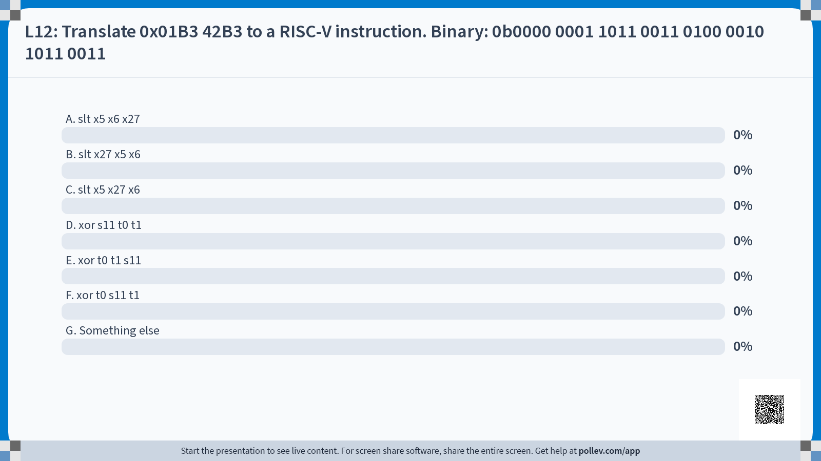

Slide 18
Your Turn: Hex → Instruction
E. xor t0 t1 s11
Translate these 32 bits into a RISC-V instruction:
0x01B3 42B3
1. Convert to binary → find opcode → find instruction format type
0b0000 0001 1011 0011 0100 0010 1011 0011
2. Split into fields according to instruction format (here, R-Type).
3. Determine opname with funct3, funct7.
4. Determine registers / register names.
31 | 25 | 24 | 20 | 19 | 15 | 14 | 12 | 11 | 7 | 6 | 0
funct7 |  | rs2 |  | rs1 |  | funct3 |  | rd |  | opcode
0000000 |  | 11011 |  | 00110 |  | 100 |  | 00101 |  | 0110011
x27
s11
x6
t1
x5
t0
R-format
“xor”

Slide 19
RV32I R-Type (1/3): All 10 instructions
See reference card on course website.
I-Type: How many unique opcode’s?
R-Type: How many unique funct3’s? unique funct7’s?
Which instructions share funct3 fields?
What are their corresponding funct7 fields?
Why might it be useful to use “similar” field patterns?

Slide 20
RV32I R-Type (2/3)
See reference card on course website.
R-Type: How many unique opcode’s?
R-Type: How many unique funct3’s? unique funct7’s?
Which instructions share funct3 fields?
What are their corresponding funct7 fields?
Why might it be useful to use “similar” field patterns?
One: 0110011
funct3: 8 unique
funct7: 2 unique
add,sub
srl,sra
Easier to define CPU architecture! (Hint: bitmasks!)
funct7 |  |  | funct3 |  | opcode
0000000 | rs2 | rs1 | 000 | rd | 0110011 | add
0100000 | rs2 | rs1 | 000 | rd | 0110011 | sub
0000000 | rs2 | rs1 | 101 | rd | 0110011 | srl
0100000 | rs2 | rs1 | 101 | rd | 0110011 | sra
0000000 | rs2 | rs1 | 001 | rd | 0110011 | sll
2’s comp negate rs2
sign extend

Slide 21
RV32I R-Type (3/3): Reference
Eight funct3 fields for ten instructions
funct7 |  |  | funct3 |  | opcode
0000000 | rs2 | rs1 | 000 | rd | 0110011 | add
0100000 | rs2 | rs1 | 000 | rd | 0110011 | sub
0000000 | rs2 | rs1 | 111 | rd | 0110011 | and
0000000 | rs2 | rs1 | 110 | rd | 0110011 | or
0000000 | rs2 | rs1 | 100 | rd | 0110011 | xor
0000000 | rs2 | rs1 | 001 | rd | 0110011 | sll
0000000 | rs2 | rs1 | 101 | rd | 0110011 | srl
0100000 | rs2 | rs1 | 101 | rd | 0110011 | sra
0000000 | rs2 | rs1 | 010 | rd | 0110011 | slt
0000000 | rs2 | rs1 | 011 | rd | 0110011 | sltu
2’s comp negation of rs2
set less than (see refcard)
sign
extend

Slide 22
I-Type Instructions

Slide 23
I-Type Instruction Format
Register-Immediate Arithmetic Instructions
addi, xori, etc.
…and more
Immediates are integers immediately defined in the instruction itself.
opname rd rs1 imm
31 |  |  | 20 | 19 | 15 | 14 | 12 | 11 | 7 | 6 | 0
imm[11:0] |  |  |  | rs1 |  | funct3 |  | rd |  | opcode
12 |  |  |  | 5 |  | 3 |  | 5 |  | 7
Imm[11:0] holds 12-bit wide immediate values
Range: [-2048, +2047]
CPU sign-extends to 32 bits before using in an arithmetic operation
(more later) How to handle immediates > 12 bits?
“Source” Register 1
second operand
“Destination” Register
gets result of computation

Slide 24
I-Type Example
addi x15 x1 -50
31 |  |  | 20 | 19 | 15 | 14 | 12 | 11 | 7 | 6 | 0
imm[11:0] |  |  |  | rs1 |  | funct3 |  | rd |  | opcode
111111001110 |  |  |  | 00001 |  | 000 |  | 01111 |  | 0010011
7 |  | 5 |  | 5 |  | 3 |  | 5 |  | 7
-50
x1
x15
I-Type opcode, arithmetic
Two’s complement:
0…0110010 +50
1…1001101
1…1001110 -50
“add”

Slide 25
Immediate Fields Need to be Wider
opname rd rs1 rs2
R-Type:
31 | 25 | 24 | 20 | 19 | 15 | 14 | 12 | 11 | 7 | 6 | 0
funct7 |  | rs2 |  | rs1 |  | funct3 |  | rd |  | opcode
7 |  | 5 |  | 5 |  | 3 |  | 5 |  | 7
opname rd rs1 imm
I-Type:
31 |  |  | 20 | 19 | 15 | 14 | 12 | 11 | 7 | 6 | 0
imm[11:0] |  |  |  | rs1 |  | funct3 |  | rd |  | opcode
12 |  |  |  | 5 |  | 3 |  | 5 |  | 7
If we used R-Type for immediates by replacing rs2 with imm…
We’d only be able to represent 32 immediate values in a 5-bit field.
Immediates are often much bigger!
Regardless, I-Type is mostly consistent with R-Type. Simplify how the CPU processes instructions!

Slide 26
I*-Type Instructions, Load Instructions

Slide 27
RV32I I-Type (1/6): All 17 Instructions
See reference card on course website. Consider both I-Type and I*-Type.
I-Type: How many unique opcode’s?
funct3: What similarities are there to R-type?
What are “I*-Type” instructions? (What kind of arithmetic operation?)
→ Why do we only need 5 bits for imm?
What are the upper 7 bits used for? What similarities are there to R-type?
Why does load also use I-Type instruction format?
What about jalr?
(challenge) Why does store not use I-Type?

Slide 28
RV32I I-Type (2/6)
See reference card on course website. Consider both I-Type and I*-Type.
I-Type: How many unique opcode’s?
funct3: What similarities are there to R-type?
Arithmetic: 0010011
Load: 0000011
jalr: 1100111
Other: 1110011
funct3
000 | add
000 | sub
111 | and
110 | or
100 | xor
001 | sll
101 | srl
101 | sra
010 | slt
011 | sltu
funct3
000 | addi
111 | andi
110 | ori
100 | xori
001 | slli
101 | srli
101 | srai
010 | slti
011 | sltiu
Same funct3 fields as corresponding R-format operation (remember, no subi)

Slide 29
RV32I I-Type (3/6):“I*-Type”
3. What are “I*-Type” instructions? (What kind of arithmetic operation?)
→ Why do we only need 5 bits for imm?
What are the upper 7 bits used for? What similarities are there to R-type?
“I*-Type”: “shift by immediate” instructions!
imm[4:0]: max shift of 32 bits (anything larger will shift all data off register)
imm[11:5]: sign extend, similar to R-Type funct7 field.
 |  |  | funct3 |  | opcode
imm[11:0] |  | rs1 | 000 | rd | 0010011 | addi
0000000 | imm[4:0] | rs1 | 001 | rd | 0110011 | slli
0000000 | imm[4:0] | rs1 | 101 | rd | 0110011 | srli
0100000 | imm[4:0] | rs1 | 101 | rd | 0110011 | srai
I-Type
“I*-Type”
(see 12-bit imm field)

Slide 30
RV32I I-Type (4/6): Load Instructions
4. Why does load also use I-Type instruction format?
Need arithmetic immediate op: compute memory address!
loadop rd imm(rs1)
31 |  |  | 20 | 19 | 15 | 14 | 12 | 11 | 7 | 6 | 0
imm[11:0] |  |  |  | rs1 |  | funct3 |  | rd |  | opcode
12 |  |  |  | 5 |  | 3 |  | 5 |  | 7
Imm[11:0] “offset”
Add to base register to form memory address
“Base” Register
Base address of load
“Destination” Register
receives value loaded from memory
Load address = (Base Register) + (Immediate Offset)

Slide 31
Load Example
lw x14 8(x2)
31 |  |  | 20 | 19 | 15 | 14 | 12 | 11 | 7 | 6 | 0
imm[11:0] |  |  |  | rs1 |  | funct3 |  | rd |  | opcode
000000001000 |  |  |  | 00010 |  | 010 |  | 01110 |  | 0000011
7 |  | 5 |  | 5 |  | 3 |  | 5 |  | 7
"offset"
+8
"base"
x2
x14
I-Type opcode, load
“Load word”
Load address = (Base Register) + (Immediate Offset)

Slide 32
Load Instructions
[review]
lb: “load byte,” lh: “load halfword” (16 bits)
Sign extend to fill upper bits of destination 32-bit register.
lbu: “load unsigned byte,” lhu: “load unsigned halfword”
Zero extend to fill upper bits of destination 32-bit register.
Note no lwu instruction in RISC-V.
Simplicity: Nothing to extend when loading 32 bits to 32-bit register.
(new) How is funct3 designed? (Hint: data size, signedness)
 |  |  | funct3 |  | opcode
imm[11:0] |  | rs1 | 000 | rd | 0000011 | lb
imm[11:0] |  | rs1 | 100 | rd | 0000011 | lbu
imm[11:0] |  | rs1 | 001 | rd | 0000011 | lh
imm[11:0] |  | rs1 | 101 | rd | 0000011 | lhu
imm[11:0] |  | rs1 | 010 | rd | 0000011 | lw

Slide 33
RV32I I-Type (5/6): Reference (Arithmetic)
 |  |  | funct3 |  | opcode
imm[11:0] |  | rs1 | 000 | rd | 0010011 | addi
imm[11:0] |  | rs1 | 111 | rd | 0010011 | andi
imm[11:0] |  | rs1 | 110 | rd | 0010011 | ori
imm[11:0] |  | rs1 | 100 | rd | 0010011 | xori
0000000 | imm[4:0] | rs1 | 001 | rd | 0010011 | slli
0000000 | imm[4:0] | rs1 | 101 | rd | 0010011 | srli
0100000 | imm[4:0] | rs1 | 101 | rd | 0010011 | srai
imm[11:0] |  | rs1 | 010 | rd | 0010011 | slti
imm[11:0] |  | rs1 | 011 | rd | 0010011 | sltiu

Slide 34
RV32I I-Type (5/6): Reference (Load, Jump)
 |  |  | funct3 |  | opcode
imm[11:0] |  | rs1 | 000 | rd | 0000011 | lb
imm[11:0] |  | rs1 | 100 | rd | 0000011 | lbu
imm[11:0] |  | rs1 | 001 | rd | 0000011 | lh
imm[11:0] |  | rs1 | 101 | rd | 0000011 | lhu
imm[11:0] |  | rs1 | 010 | rd | 0000011 | lw
imm[11:0] |  | rs1 | 000 | rd | 1100111 | jalr
ecall, ebreak out of scope

Slide 35
S-Format Layout (Store)

Slide 36
S-Type Instruction Format
Store Instructions have their own format.
sw, sh, sw
Immediate’s higher 7 bits and lower 5 bits are in separate fields!
storeop rs2 imm(rs1)
31 | 25 | 24 | 20 | 19 | 15 | 14 | 12 | 11 | 7 | 6 | 0
imm[11:5] |  | rs2 |  | rs1 |  | funct3 |  | imm[4:0] |  | opcode
7 |  | 5 |  | 5 |  | 3 |  | 5 |  | 7
“Source” Register
Data to be stored in memory
“Base” Register
Base address of store
Imm[11:0] “offset”
Add to base register to form memory address
Store address = (Base Register) + (Immediate Offset)

Slide 37
Store Example
sw x14 36(x2)
31 |  |  | 20 | 19 | 15 | 14 | 12 | 11 | 7 | 6 | 0
imm[11:5] |  | rs2 |  | rs1 |  | funct3 |  | imm[4:0] |  | opcode
0000001 |  | 01110 |  | 00010 |  | 010 |  | 00100 |  | 0100011
7 |  | 5 |  | 5 |  | 3 |  | 5 |  | 7
"source"
x14
"base"
x2
S-Type opcode
“Store word”
imm[11:5] |  | imm[4:0]
0000001 |  | 00100
"offset"

Slide 38
S-Type Simplifies Hardware Design
R-Type
31 | 25 | 24 | 20 | 19 | 15 | 14 | 12 | 11 | 7 | 6 | 0
funct77 |  | rs2 |  | rs1 |  | funct3 |  | rd |  | opcode
7 |  | 5 |  | 5 |  | 3 |  | 5 |  | 7
I-Type
31 |  |  | 20 | 19 | 15 | 14 | 12 | 11 | 7 | 6 | 0
imm[11:0] |  |  |  | rs1 |  | funct3 |  | rd |  | opcode
7 |  | 5 |  | 5 |  | 3 |  | 5 |  | 7
S-Type
31 | 25 | 24 | 20 | 19 | 15 | 14 | 12 | 11 | 7 | 6 | 0
imm[11:5] |  | rs2 |  | rs1 |  | funct3 |  | imm[4:0] |  | opcode
7 |  | 5 |  | 5 |  | 3 |  | 5 |  | 7
Why split up the immediate field in S-Type?
RISC-V ISA design prioritizes keeping register fields in the same places:
“Read” registers in same bitrange across format types
“Write” registers, too
Immediates less critical
Critical for simple hardware design! (more later)

Slide 39
S-Type Instructions: Reference
Recall store writes to memory only the specified bytes, so no sign/logical extension
Same funct3 fields as load instructions
 |  |  | funct3 |  | opcode
imm[11:5] | rs2 | rs1 | 000 | imm[4:0] | 0100011 | sb
imm[11:5] | rs2 | rs1 | 001 | imm[4:0] | 0100011 | sh
imm[11:5] | rs2 | rs1 | 010 | imm[4:0] | 0100011 | sw

Slide 40
And in Conclusion…
Simplification works for RISC-V: Instructions are same size as data word (32 bits) so that they use the same memory.
Computer program stored as a series of these 32-bit numbers.
RISC-V machine language instruction formats:
Next time: B-Type, U-Type, J-Type
R-Type
31 | 25 | 24 | 20 | 19 | 15 | 14 | 12 | 11 | 7 | 6 | 0
funct77 |  | rs2 |  | rs1 |  | funct3 |  | rd |  | opcode
7 |  | 5 |  | 5 |  | 3 |  | 5 |  | 7
I-Type
31 |  |  | 20 | 19 | 15 | 14 | 12 | 11 | 7 | 6 | 0
imm[11:0] |  |  |  | rs1 |  | funct3 |  | rd |  | opcode
7 |  | 5 |  | 5 |  | 3 |  | 5 |  | 7
S-Type
31 | 25 | 24 | 20 | 19 | 15 | 14 | 12 | 11 | 7 | 6 | 0
imm[11:5] |  | rs2 |  | rs1 |  | funct3 |  | imm[4:0] |  | opcode
7 |  | 5 |  | 5 |  | 3 |  | 5 |  | 7

Slide 41
Extra Exercises

Slide 42
Your Turn
How do we encode add x4 x3 x2 ?
Lookup table:
funct3
A. 4021 8233_{hex}
B. 0021 82b3_{hex}
C. 4021 82b3_{hex}
D. 0021 8233_{hex}
E. 0021 8234_{hex}
F. Something else
funct7 |  |  | funct3 |  | opcode
0000000 | rs2 | rs1 | 000 | rd | 0110011 | add
0100000 | rs2 | rs1 | 000 | rd | 0110011 | sub
0000000 | rs2 | rs1 | 100 | rd | 0110011 | xor
0000000 | rs2 | rs1 | 111 | rd | 0110011 | and
31 | 25 | 24 | 20 | 19 | 15 | 14 | 12 | 11 | 7 | 6 | 0
funct7 |  | rs2 |  | rs1 |  | funct3 |  | rd |  | opcode

Slide 43
Your Turn: Solution
How do we encode add x4 x3 x2 ?
Lookup table:
funct3
A. 4021 8233_{hex}
B. 0021 82b3_{hex}
C. 4021 82b3_{hex}
D. 0021 8233_{hex}
E. 0021 8234_{hex}
F. Something else
funct7 |  |  | funct3 |  | opcode
0000000 | rs2 | rs1 | 000 | rd | 0110011 | add
0100000 | rs2 | rs1 | 000 | rd | 0110011 | sub
0000000 | rs2 | rs1 | 100 | rd | 0110011 | xor
0000000 | rs2 | rs1 | 111 | rd | 0110011 | and
31 | 25 | 24 | 20 | 19 | 15 | 14 | 12 | 11 | 7 | 6 | 0
funct7 |  | rs2 |  | rs1 |  | funct3 |  | rd |  | opcode
0000000
00010
00011
000
00100
0110011
hex
0
0
2
1
8
2
3
3

